Slide 1
Food
Lifestyle
Exercise
eXperience
Most Flexible diet & workout manager
Motivation
Prior studies and works
Key function
Database
Manu Gomez, 신재욱, 이지훈, 홍마노

Slide 2
MOTIVATION
Increasing Health Issues Related to Diet
Growing Interest in Health and Wellness
Many apps or video for how to Workout, or what to eat for diet.
But there is nothing just for US.
Not personalized in Workout & Meal plan
Suggest Personalized
Meal plan & Workout plan
By users needs.
So now…,
Obesity is growing ~1% each year
Lack of knowledge
Problem in last apps & videos
So, FLEX is
They recommend same thing for different people.

Slide 3
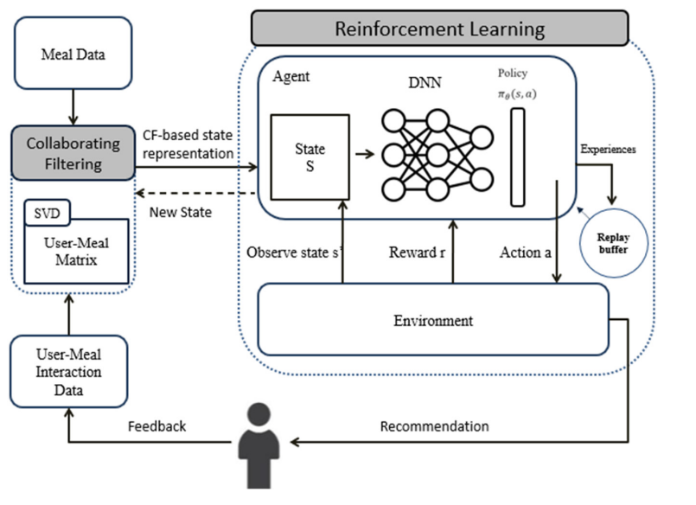
PRIOR STUDIES AND WORKS
Delighting Palates with AI
The cited paper presents a method combining reinforcement learning and collaborative filtering to create personalized meal plans that meet users' nutritional needs and preferences, aiming to enhance long-term adherence. However, it does not address exercise planning, which limits its effectiveness for users seeking both dietary and physical activity recommendations to meet health goals.
AI Meal Planner App
This work generates meal plans suggestion based on a user's age,height, gender. But it does not consider about exercise and users taste.
Notes:
So.., we find related paper and work
The goal of first paper is to create dynamic meal plans that balance nutritional goals and user preferences, while continuously incorporating user feedback to improve user satisfaction and adherence. The paper focuses on two key technologies: Collaborative Filtering (CF) and Reinforcement Learning (RL).
Collaborative Filtering involves calculating similarities between users based on their preferences to generate initial recommendations. Reinforcement Learning, on the other hand, improves the quality of recommendations by continuously learning from the feedback on user satisfaction with the suggested meal plans.
And secondly , this AI Meal Planner App generates meal plans suggestion based on a user's age,height, gender.
But it does not consider about exercises and users taste. It means, for example, if someone is in diet, it never consider about food that user like, and do not make any calculate for users goal.
so we can upgrade it with first paper approach . make some meal plan that created by user preference. for example, if user wants spicy food, AI can recommend spicy food by calculate with users goal weight, and each foods 칼로리, fat and other things. And also make exercise program with for goal weight calculation.

Slide 4
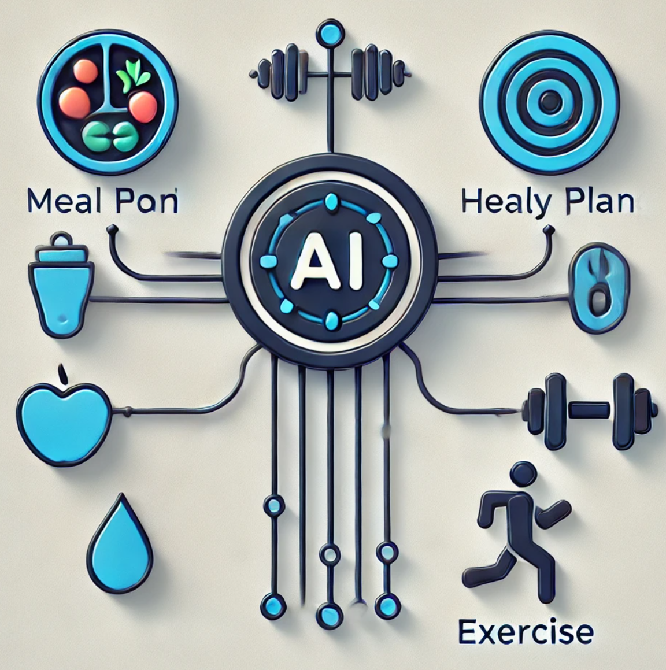
KEY FUNCTION
Comprehensive Meal and Exercise Scheduling:
→ Management of meal plans and exercise routines.
→ Analysis of individual preferences, dietary restrictions, and fitness goals.
→ Dynamic scheduling of balanced meals and workouts.
→ Easy adjustments to fit the lifestyle.
→ Combination of nutrition and physical activity for optimal health and wellness outcomes.
Meal and Exercise Tracking with Social Sharing:
→ Create a detailed health record.
→ Monitor progress and offers a social sharing feature.
→ Enables sharing of accomplishments with friends or fitness communities.
→ Promotes motivation to stay consistent with health goals.
→ Create community and support.

Slide 5

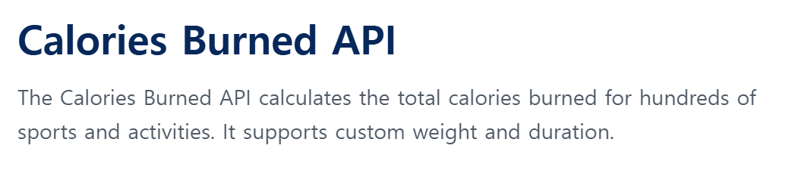

DATABASE
EDAMAM - Food Database API
Nutritional Data, Recipes, Health labels, Ingredient analysis…
Log their daily intake
Restrictions: Diet preferences, Allergies, Intolerances, Calorie Limits and Macronutrient Balances
API Ninjas - Calories Burned API
Calories burned for various activities
Based on activity types, weight and duration

Slide 6
THANK YOU
Manu Gomez, 신재욱, 이지훈, 홍마노

